Slide 1
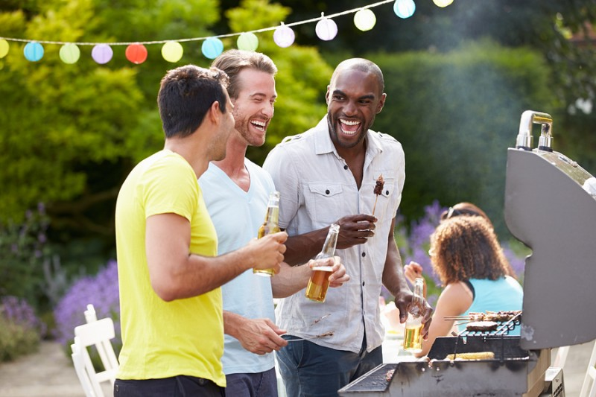


Slide 2
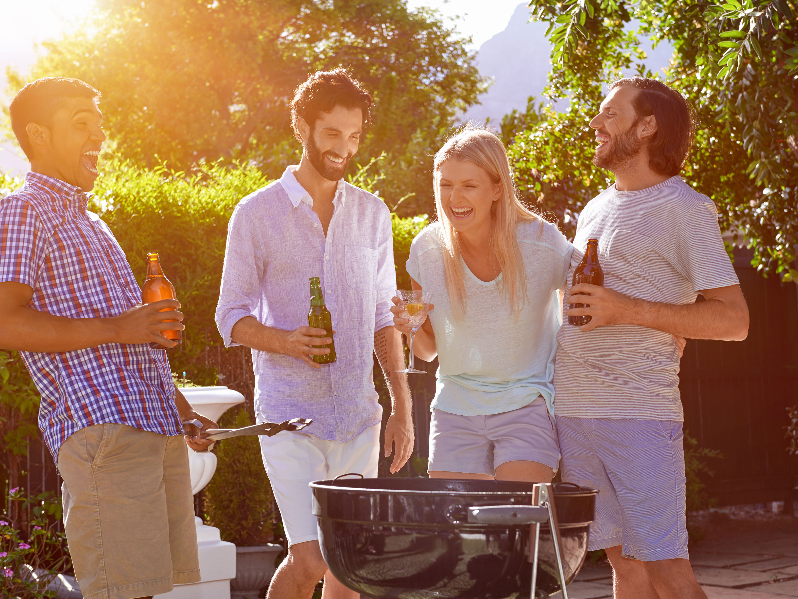
OUR VISION
Who ?
My vision is to create an easy to use, clean,functional, one stop recipe website.
My Name Is Benji Gansekoele. I am a computer programming student at Conestoga College.
Why ?
Technology
I really enjoy cooking. When trying to make a delicious dinner the last thing I want is adds galore, a slow website, and something that requires a lot of time to navigate.
I used Nodejs and Mysql on this project.
Future ?
How ?
I would like to continue working on this project and make it live. There are many things to add but I think if I stick with my vision I can make it come to life.
Putting the user first is our goal. By prioritizing speed and functionality over monitization, we are putting the user first.

